Slide 1
PRESS BRIEFING AT
RENDEZ-VOUS DE SEPTEMBRE
SEPTEMBER 13, 2014

Slide 2
Alex Moczarski
President and Chief Executive Officer,
Guy Carpenter & Company
Chairman of Marsh & McLennan Companies International

Slide 3
David Priebe
Vice Chairman

Slide 4
US Property Catastrophe Rate on Line Index

Slide 5
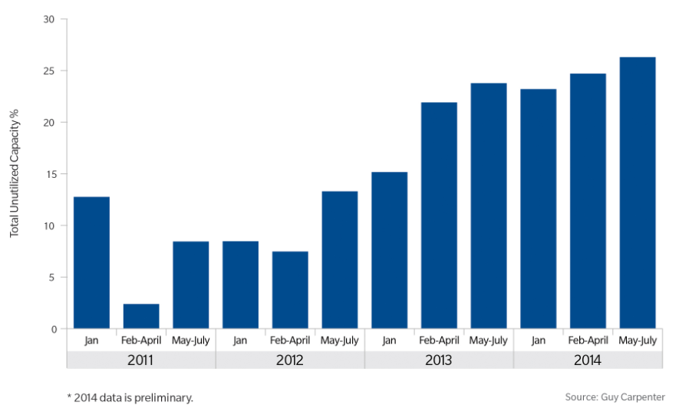
Un-utilized Authorised Capacity 2011-2014
September 13, 2014
Notes:
With continued moderate loss experience, growing reinsurer surplus and increasing alternative market capital, the percentage of excess capacity continues to climb. The June 2013 renewals still represent a high point with only approximately 70 percent of authorizations utilized as these renewals were a heavy focus for both alternative and traditional markets. However, based on a preliminary review of total capacity utilized for the May through July 2014 renewals excess capacity has increased to just over 26% from just under 23% for the same period in 2013

Slide 6
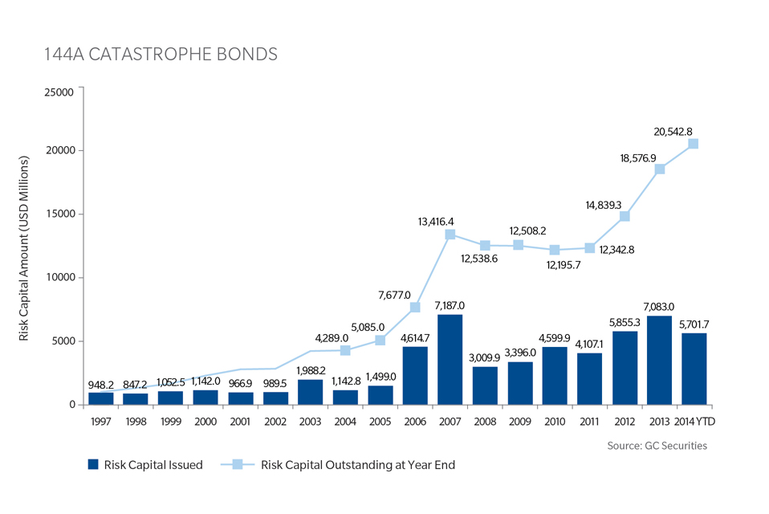
144 Catastrophe Bonds

Slide 7
Nick Frankland
Chief Executive Officer, EMEA Operations

Slide 8
Guy Carpenter Collateralised Reinsurance Usage
Notes:
From Cognos Data as at July 2014.
Billed Gross Premiums total USD743mn. GC total USD14bn,
NB Some large EMEA buyers may have bought directly, but the amount will not be significant.

Slide 9
James Nash
Chief Executive Officer-Asia Pacific,
Guy Carpenter & Company

Slide 10
Alex Moczarski
President and Chief Executive Officer,
Guy Carpenter & Company
Chairman of Marsh & McLennan Companies International

Slide 11
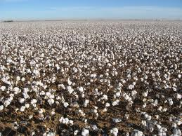
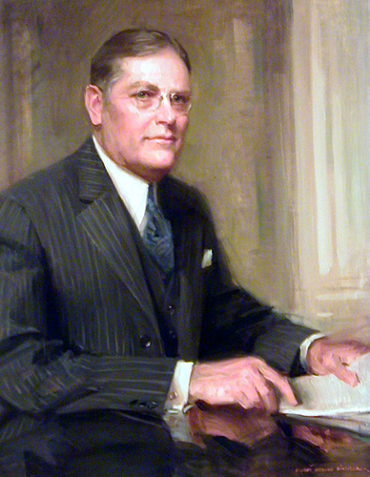
Primary Information
Secondary Information
Bulleted text in Arial left aligned
Paragraph spacing 0.6 lines before bullets
  Second level copy with 0.2 lines before
    Third level
      Fourth Level
        Fifth level
Notes:
And so to Guy Carpenter, a story today started over 90 years ago in the cotton fields of the southern-eastern United States. In the early 20th century cotton was the most commercial enterprise in this region of the USA. After harvesting from the fields, insuring the baled cotton in the warehouses as well as the cotton gins and presses was essential. Only reliable insurance stood between devastating loss and financial stability.
The Cotton Insurance Association (CIA) was a pool of insurance companies formed to spread the risk associated with the storage of the cotton before it could be sold at market. However, the members alone could not always absorb the full amount of risk so they had to buy reinsurance.
As a young man in the cotton insurance business, he started at the age of 15, Mr Guy Carpenter discovered that the business was haphazard and reactive. A year of big losses pushed the next year’s premiums too high; a lucky year sent prices down, often exposing insurers and reinsurers to more risk than they had expected. .
Carpenter had a better idea: rates based on a rolling average of losses over many years. The rolling average identified the signal in the noise of year-to-year fluctuations. The “Carpenter Plan” enabled insurance of all losses over a certain level. For the first time, producers and insurers could anticipate rates and manage costs. It was called excess of loss reinsurance.
In 1923 Carpenter met with cotton insurance brokers Henry W. Marsh and Donald R. McLennan during a transatlantic crossing. The merged firm of Marsh and McLennan, today’s MMCo, would take the nascent science of quantitative analytics beyond cotton. Along with quantitative precision, precise language became a hallmark of the firm. Carpenter insisted on clarity: Contracts were more inclusive, citing only those perils that were excluded. Contract language written by Carpenter himself still appears in reinsurance contracts issued by us and our competitors around the world.

Slide 12
The Cat Gap
Source: Guy Carpenter, Swiss Re

