Slide 1
Alex Moczarski
President and Chief Executive Officer,
Guy Carpenter & Company
Chairman of Marsh & McLennan Companies International

Slide 2
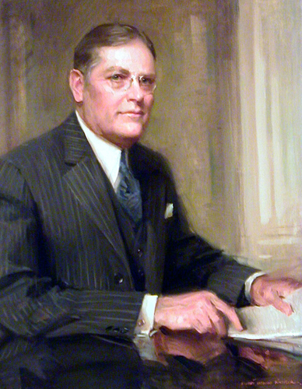
Primary Information Secondary Information
Bulleted text in Arial left aligned
Paragraph spacing 0.6 lines before bullets
Second level copy with 0.2 lines before
Third level
Fourth Level
Fifth level
Notes:
And so to Guy Carpenter, a story today started over 90 years ago in the cotton fields of the southern-eastern United States. In the early 20th century cotton was the most commercial enterprise in this region of the USA. After harvesting from the fields, insuring the baled cotton in the warehouses as well as the cotton gins and presses was essential. Only reliable insurance stood between devastating loss and financial stability.
The Cotton Insurance Association (CIA) was a pool of insurance companies formed to spread the risk associated with the storage of the cotton before it could be sold at market. However, the members alone could not always absorb the full amount of risk so they had to buy reinsurance.
As a young man in the cotton insurance business, he started at the age of 15, Mr Guy Carpenter discovered that the business was haphazard and reactive. A year of big losses pushed the next year’s premiums too high; a lucky year sent prices down, often exposing insurers and reinsurers to more risk than they had expected. .
Carpenter had a better idea: rates based on a rolling average of losses over many years. The rolling average identified the signal in the noise of year-to-year fluctuations. The “Carpenter Plan” enabled insurance of all losses over a certain level. For the first time, producers and insurers could anticipate rates and manage costs. It was called excess of loss reinsurance.
In 1923 Carpenter met with cotton insurance brokers Henry W. Marsh and Donald R. McLennan during a transatlantic crossing. The merged firm of Marsh and McLennan, today’s MMCo, would take the nascent science of quantitative analytics beyond cotton. Along with quantitative precision, precise language became a hallmark of the firm. Carpenter insisted on clarity: Contracts were more inclusive, citing only those perils that were excluded. Contract language written by Carpenter himself still appears in reinsurance contracts issued by us and our competitors around the world.

Slide 3
The Cat Gap
Source: Guy Carpenter, Swiss Re

