Slide 1
David Priebe
Vice Chairman

Slide 2
US Property Catastrophe Rate on Line Index

Slide 3
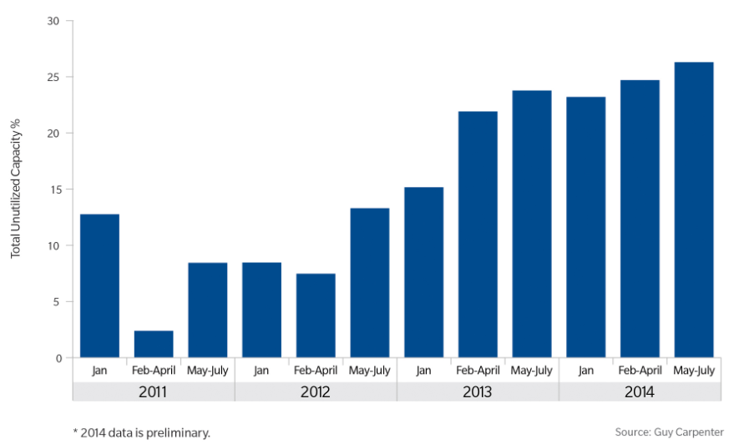
Un-utilized Authorised Capacity 2011-2014
September 12, 2014
Notes:
With continued moderate loss experience, growing reinsurer surplus and increasing alternative market capital, the percentage of excess capacity continues to climb. The June 2013 renewals still represent a high point with only approximately 70 percent of authorizations utilized as these renewals were a heavy focus for both alternative and traditional markets. However, based on a preliminary review of total capacity utilized for the May through July 2014 renewals excess capacity has increased to just over 26% from just under 23% for the same period in 2013

Slide 4
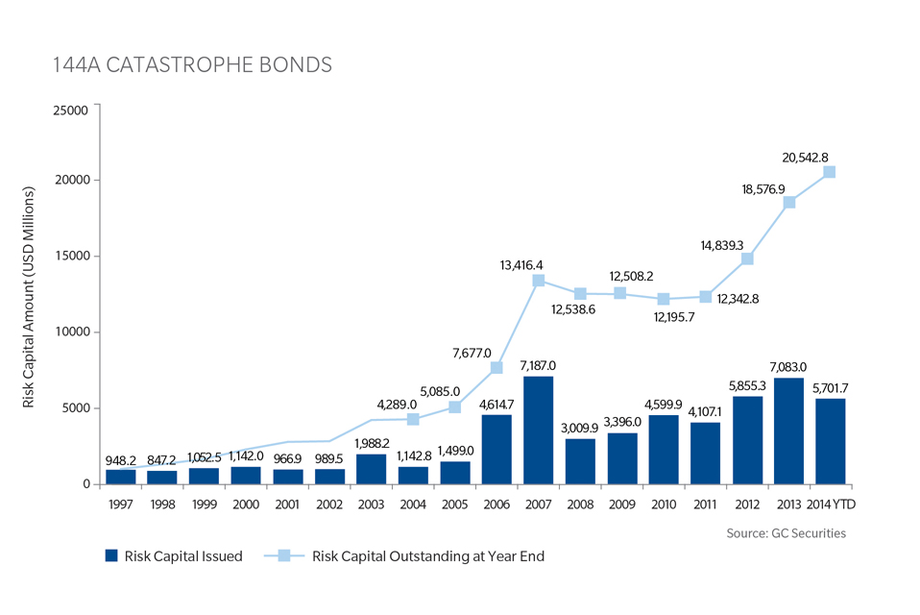
144 Catastrophe Bonds

