Slide 1
PRESS BRIEFING AT RENDEZ-VOUS DE SEPTEMBRE
SEPTEMBER 12, 2015

Slide 2
Alex Moczarski
President and Chief Executive Officer,
Guy Carpenter & Company
Chairman of Marsh & McLennan Companies International

Slide 3
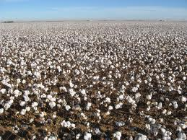
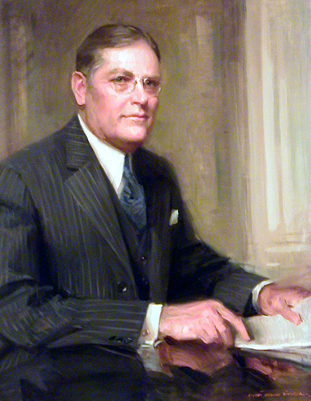
Primary Information Secondary Information
Bulleted text in Arial left aligned
Paragraph spacing 0.6 lines before bullets
Second level copy with 0.2 lines before
Third level
Fourth Level
Fifth level
Notes:
And so to Guy Carpenter, a story today started over 90 years ago in the cotton fields of the southern-eastern United States. In the early 20th century cotton was the most commercial enterprise in this region of the USA. After harvesting from the fields, insuring the baled cotton in the warehouses as well as the cotton gins and presses was essential. Only reliable insurance stood between devastating loss and financial stability.
The Cotton Insurance Association (CIA) was a pool of insurance companies formed to spread the risk associated with the storage of the cotton before it could be sold at market. However, the members alone could not always absorb the full amount of risk so they had to buy reinsurance.
As a young man in the cotton insurance business, he started at the age of 15, Mr Guy Carpenter discovered that the business was haphazard and reactive. A year of big losses pushed the next year’s premiums too high; a lucky year sent prices down, often exposing insurers and reinsurers to more risk than they had expected. .
Carpenter had a better idea: rates based on a rolling average of losses over many years. The rolling average identified the signal in the noise of year-to-year fluctuations. The “Carpenter Plan” enabled insurance of all losses over a certain level. For the first time, producers and insurers could anticipate rates and manage costs. It was called excess of loss reinsurance.
In 1923 Carpenter met with cotton insurance brokers Henry W. Marsh and Donald R. McLennan during a transatlantic crossing. The merged firm of Marsh and McLennan, today’s MMCo, would take the nascent science of quantitative analytics beyond cotton. Along with quantitative precision, precise language became a hallmark of the firm. Carpenter insisted on clarity: Contracts were more inclusive, citing only those perils that were excluded. Contract language written by Carpenter himself still appears in reinsurance contracts issued by us and our competitors around the world.

Slide 4




Delivering Client-facing Technologies
GC CAT-VIEWTM

Slide 5
David Priebe
Vice Chairman

Slide 6
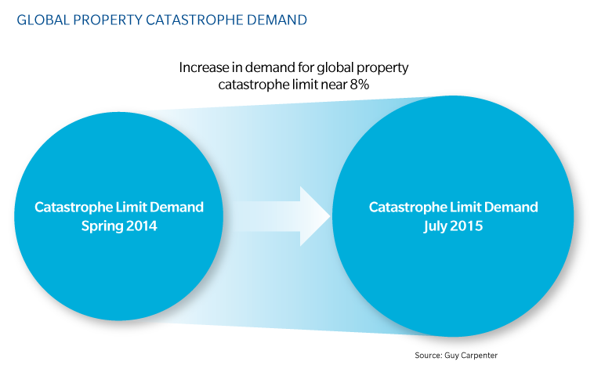
Global Property Catastrophe Demand

Slide 7
Third Party Capital as percentage of Global Property Catastrophe Capacity
Source: GC Securities

Slide 8
144 Catastrophe Bonds

Slide 9
Nick Frankland
Chief Executive Officer, EMEA Operations

Slide 10
James Nash
Chief Executive Officer-Asia Pacific,
Guy Carpenter & Company

Slide 11
Asia-Pacific General Insurance M&A 12 Months to September 2015, USD billion
Source: Bloomberg,Guy Carpenter

Slide 12
Asia-Pacific General Insurer M&A by Acquirers’ Domiciles
Source: Bloomberg,Guy Carpenter

Slide 13
Alex Moczarski
President and Chief Executive Officer,
Guy Carpenter & Company
Chairman of Marsh & McLennan Companies International

Slide 14

Growing Gap Between Economic and Insured Losses
Honshu, Japan earthquake & tsunami:
19% Insured
Katrina, Rita, Wilma:
50% Insured
Ike:
48% Insured
Sandy:
43% Insured
Andrew:
60% Insured
1990
1992
2000
2005
2008
2010
2012
2014
Global economic loss outpaces the deployment and/or recovery of insurance products

