Slide 1
David Priebe
Vice Chairman

Slide 2
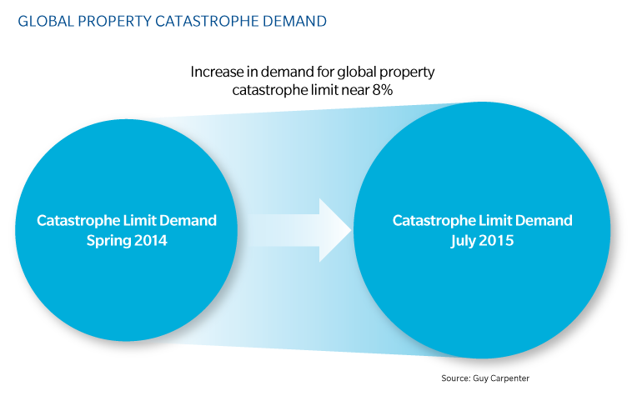
Global Property Catastrophe Demand

Slide 3
Third Party Capital as percentage of Global Property Catastrophe Capacity
Source: GC Securities

Slide 4
144 Catastrophe Bonds

